Slide 1
Dhanya Dhenu Matrix
Permutation & Combination
Matrix
नमस्ते
CEO & Founder
Hariom Nautiyal

Slide 2
About Me:
मै हरिओम नौटियाल ग्राम बड़कोट, पोस्ट डाँड़ी, रानीपोखरी, जिला देहरादून से हूँ। स्कूलिंग इलेक्ट्रॉनिक में Graduation IT में और Post Graduation कंप्यूटर साइंस में किया।
दिल्ली में As Java Software Developer, बैंगलोर में Web Developer और फिर Research में लगभग 4 साल काम किया…
2014 से धन्य धेनु उद्यमिता में हूँ…

Slide 3
Dhanya Dhenu Complete Supply Chain Management
Dairy Farm
Collection Center & S.H.G
Processing Unit
CSC Center
Training Center
P.M Digital Village
Dairy Factory
Ice-cream Factory
Pickle Factory
Live Computer Training
Franchise System
Marketing Outlet
Bank CSP
Online Sale
Off-line Sale
Door to Door

Slide 4
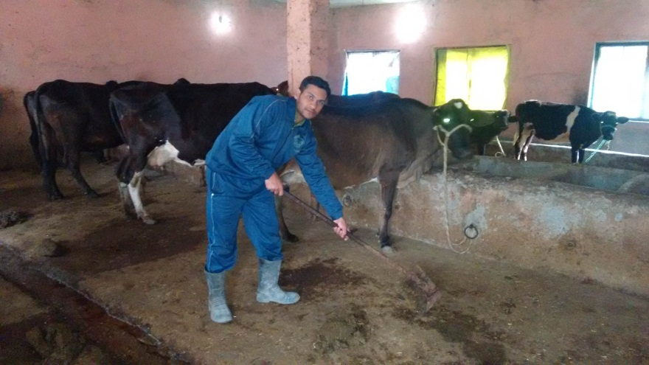
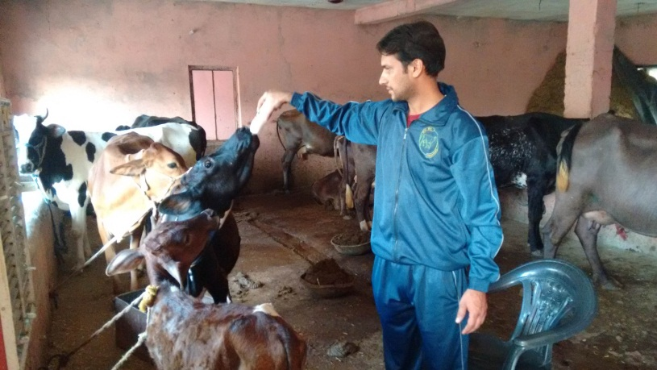
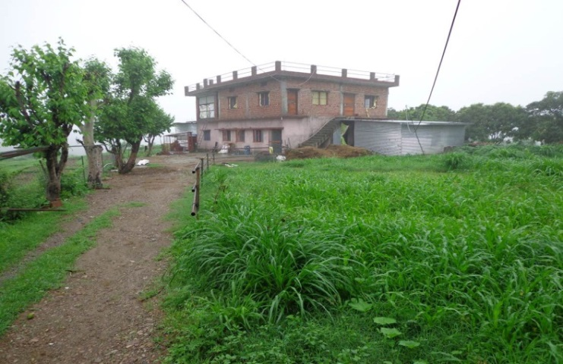
Dairy Farm:
Dhanya Dhenu Integrated Business Model
Integrated Farm

Slide 5
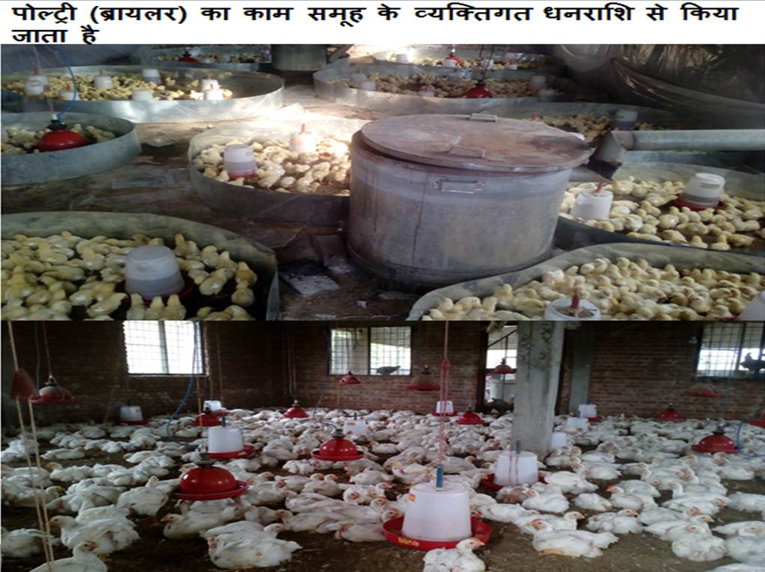
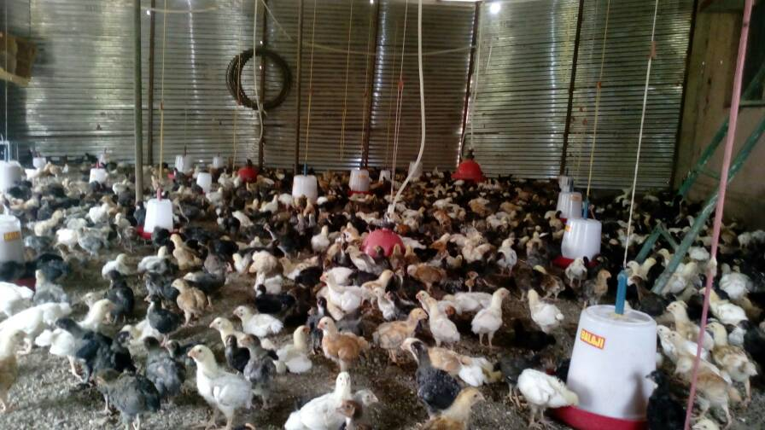
बचत बहुत अच्छी न होने के कारण ब्रायलर फार्म स्टार्ट किया
फिर कुछ समय बाद देसी अंडे वाली मुर्गे-मुर्गियां का काम "मुख्यमंत्री स्वरोजगार योजना" जिला उद्योग केंद्र से ले कर किया गया।

Slide 6
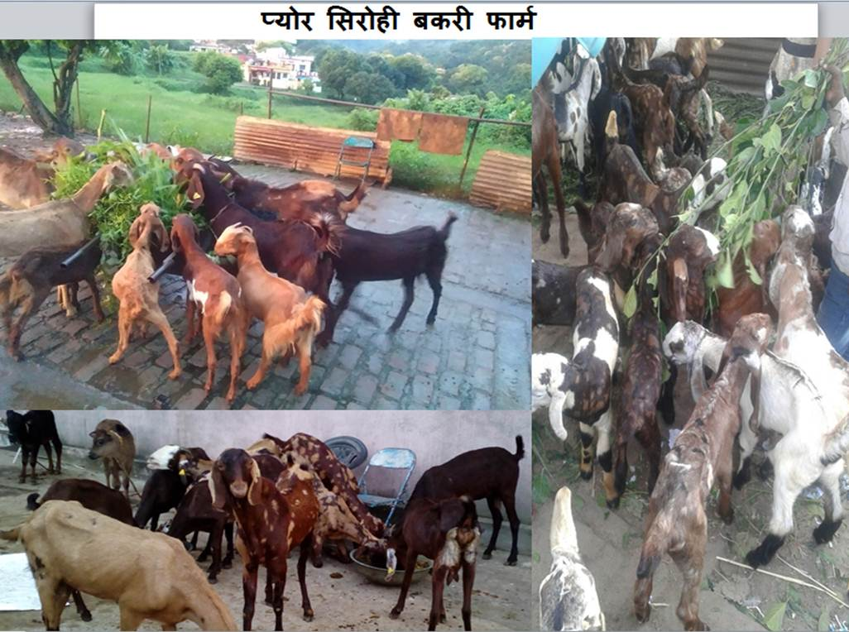

Slide 7
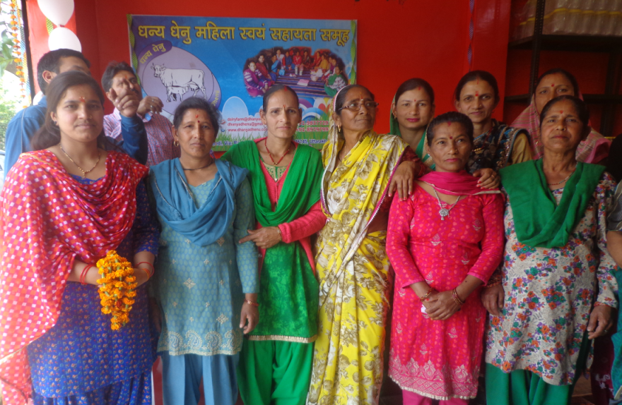
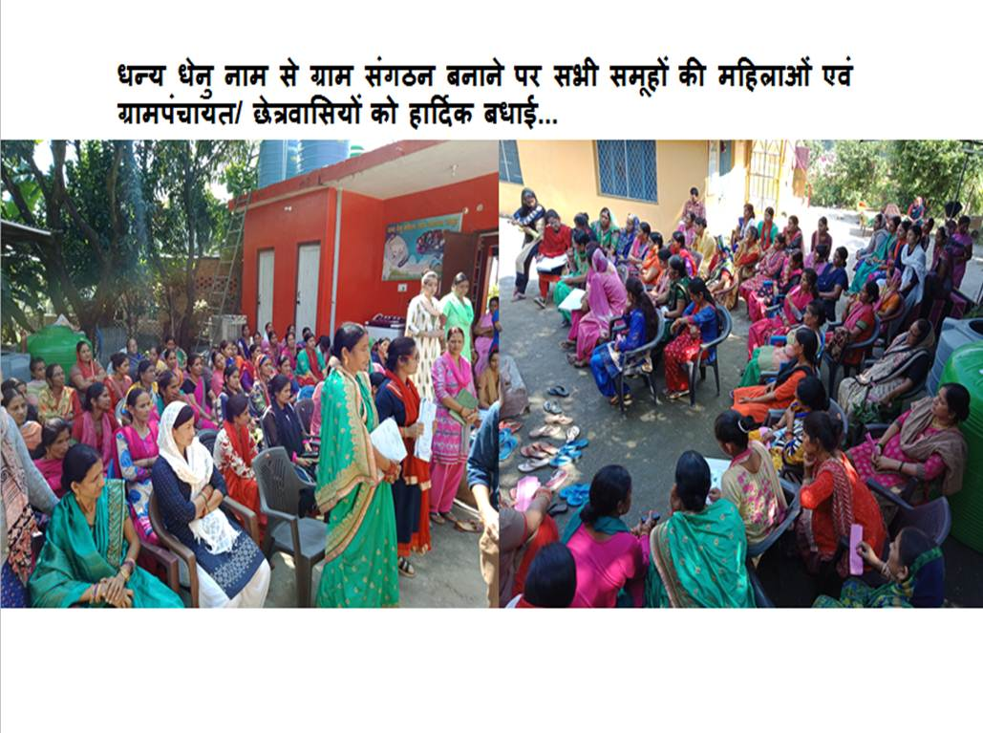
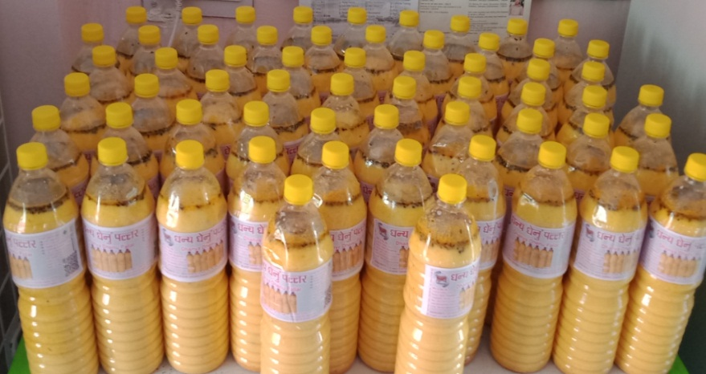
Collection Center & S.H.G:
Dhanya Dhenu Gram Sangthan (S.H.G)

Slide 8
Dairy Factory:

Slide 9
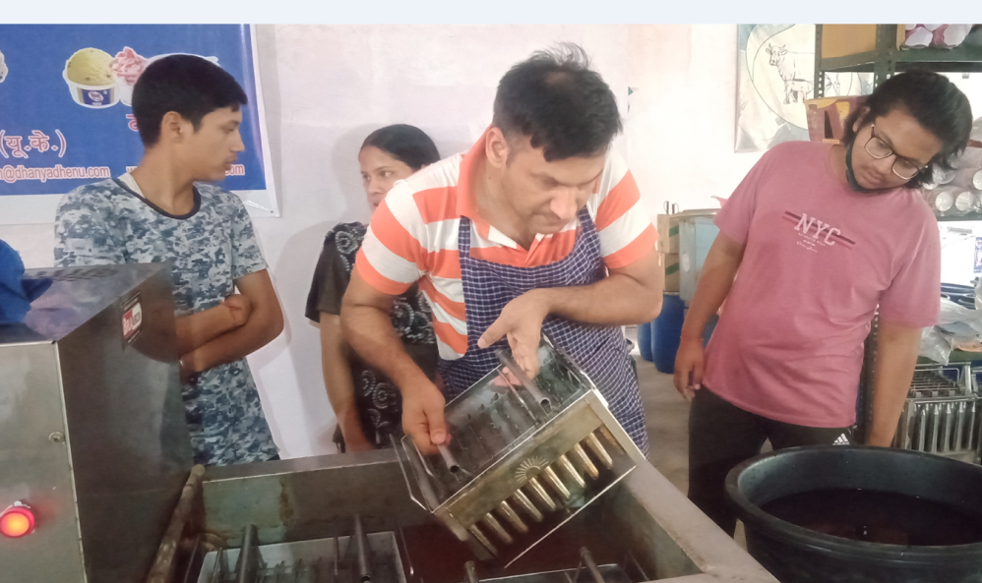
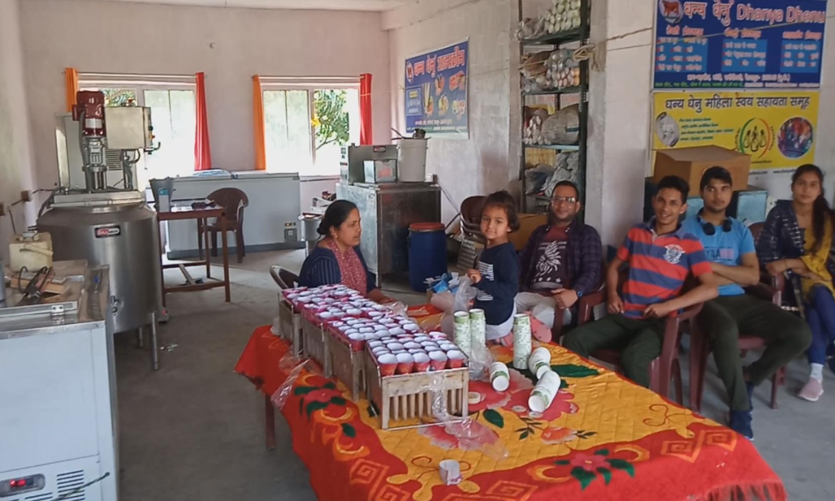
Organic Ice-cream Factory:

Slide 10
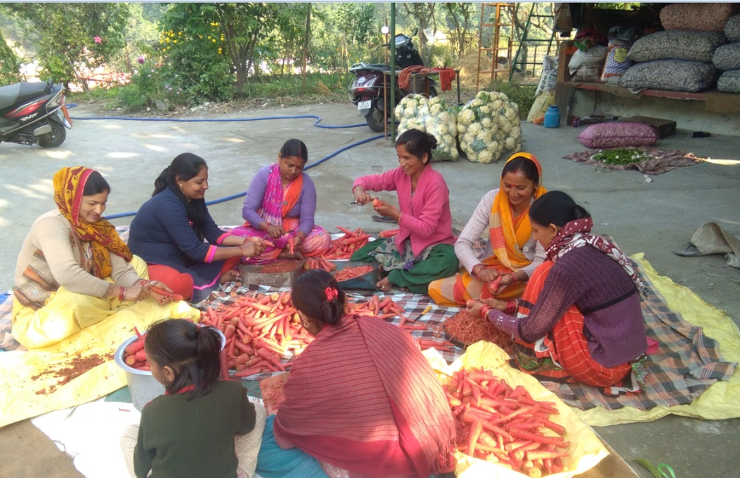
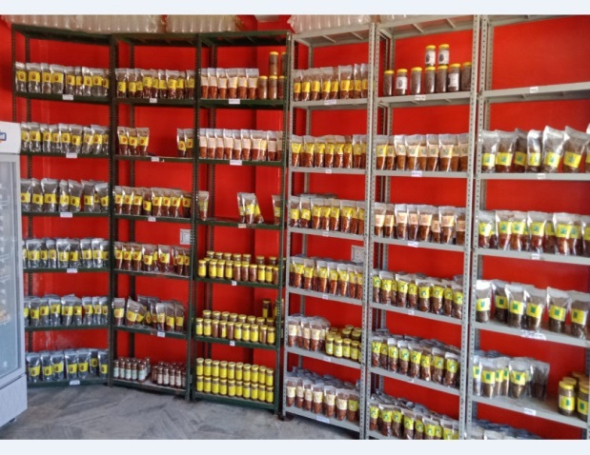
Pickle Factory:

Slide 11
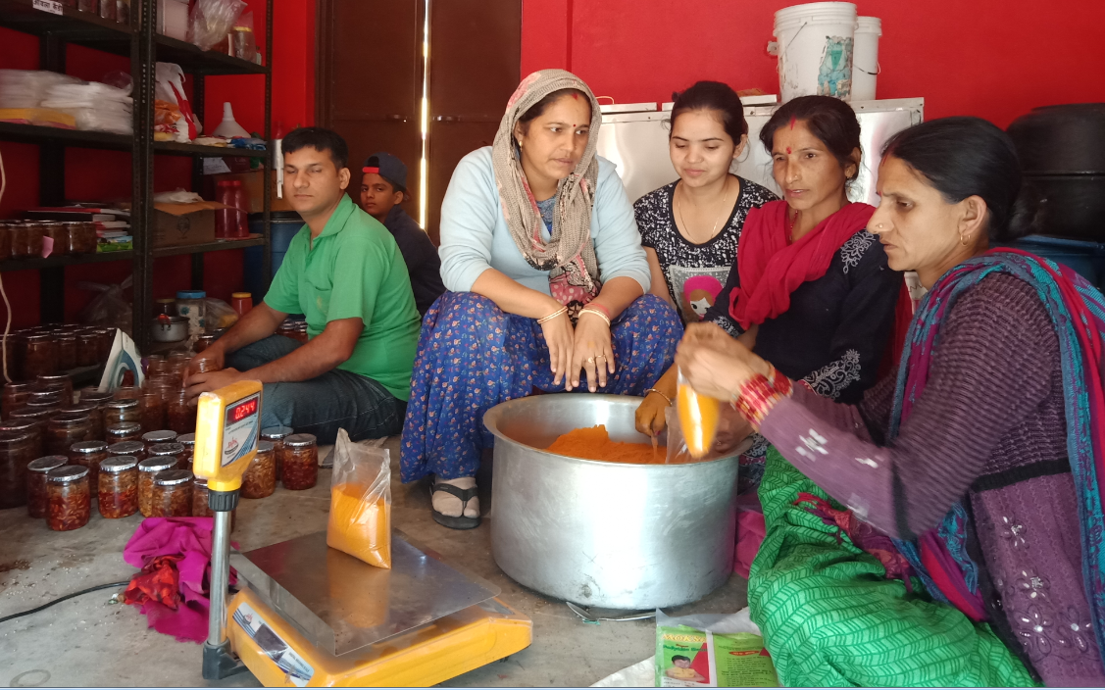
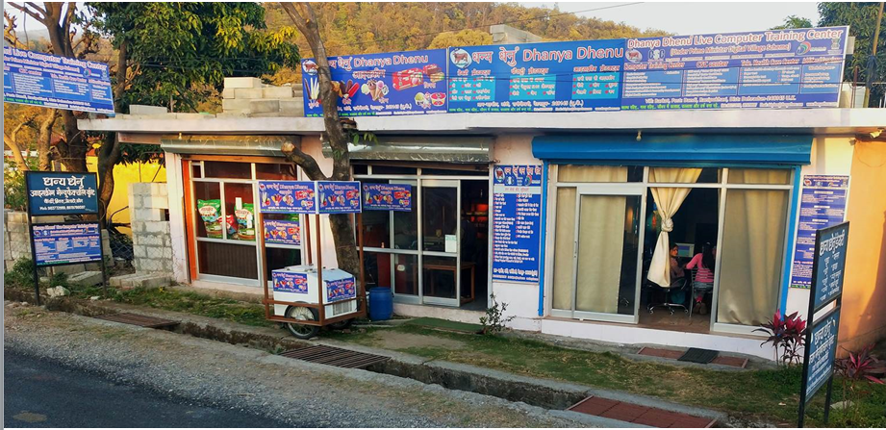
Marketing Outlets:

Slide 12
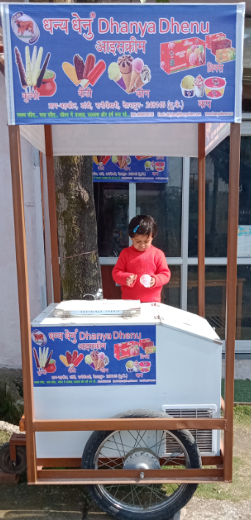
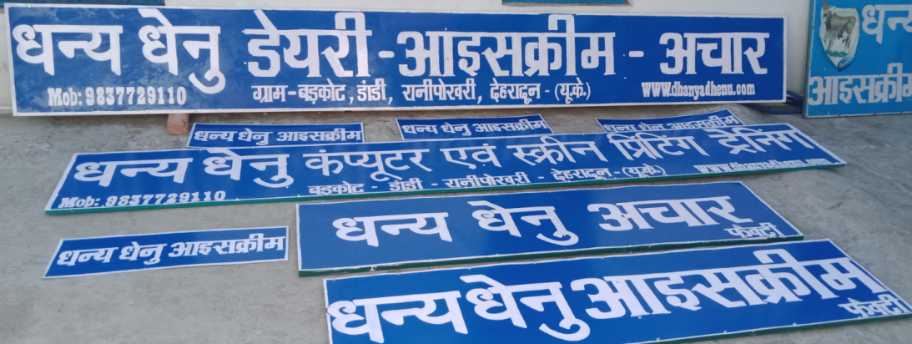
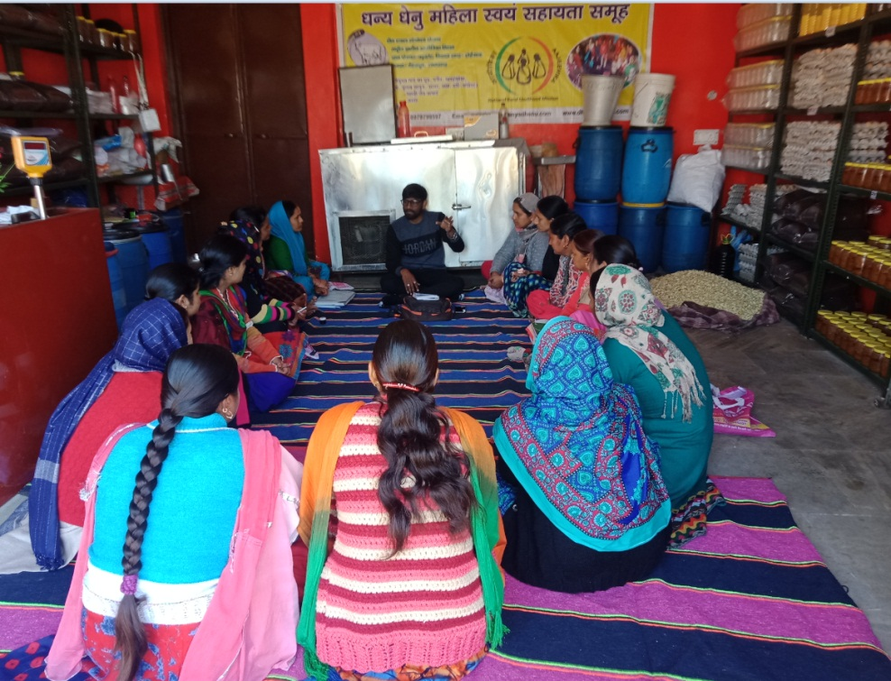
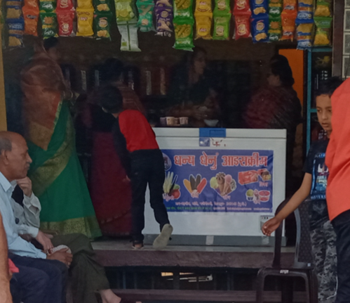
Franchise System:

Slide 13
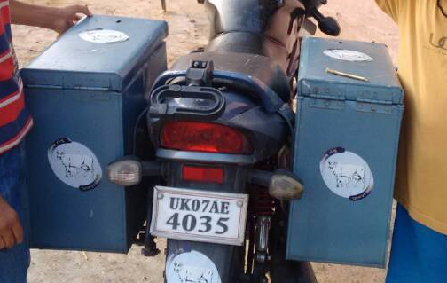
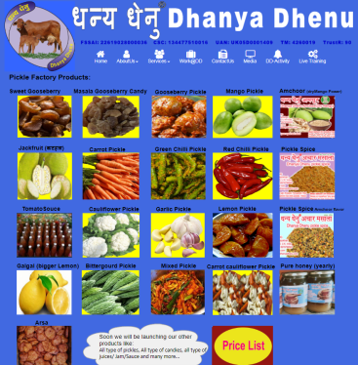
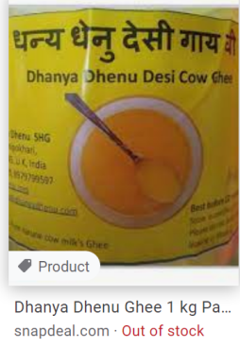
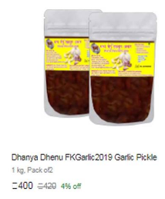
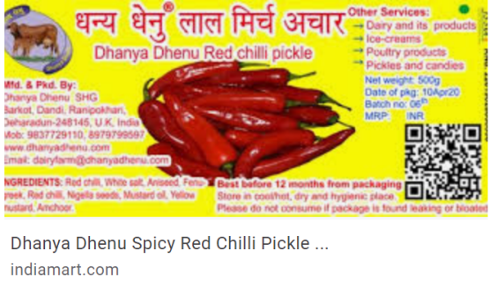
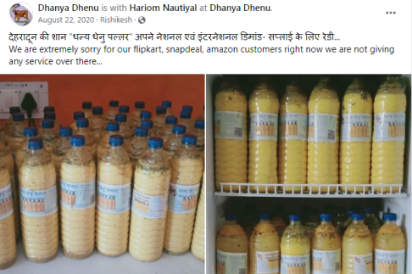
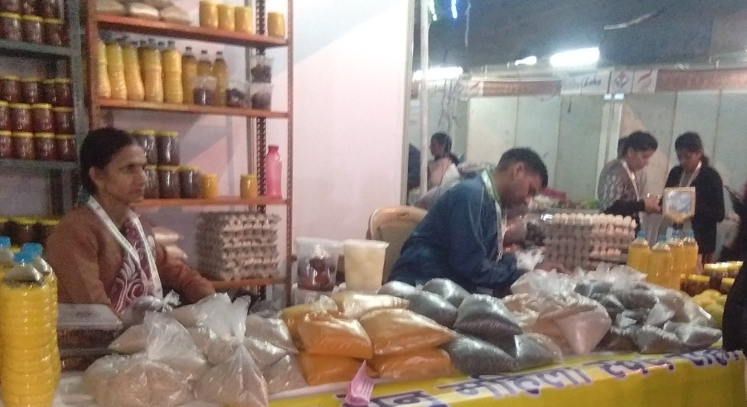
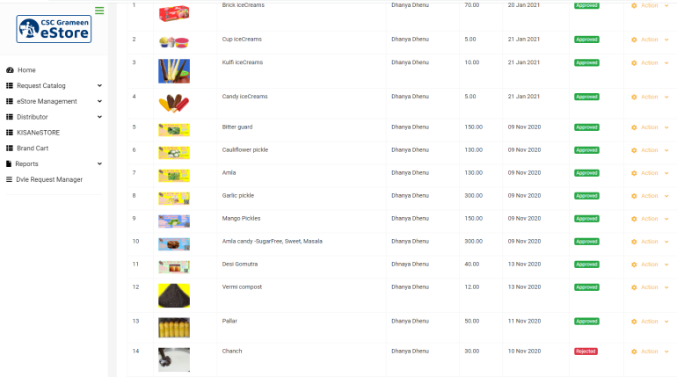
Door to Door Sale
Online Sale
Off-line Sale

Slide 14
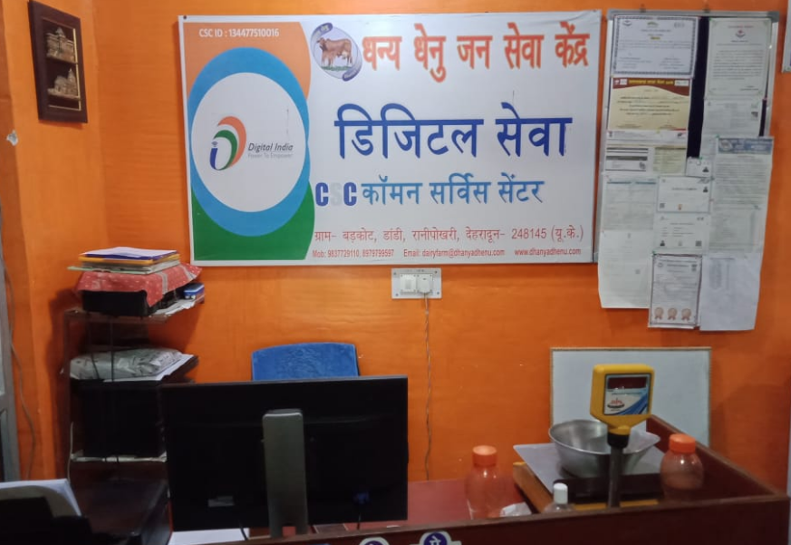
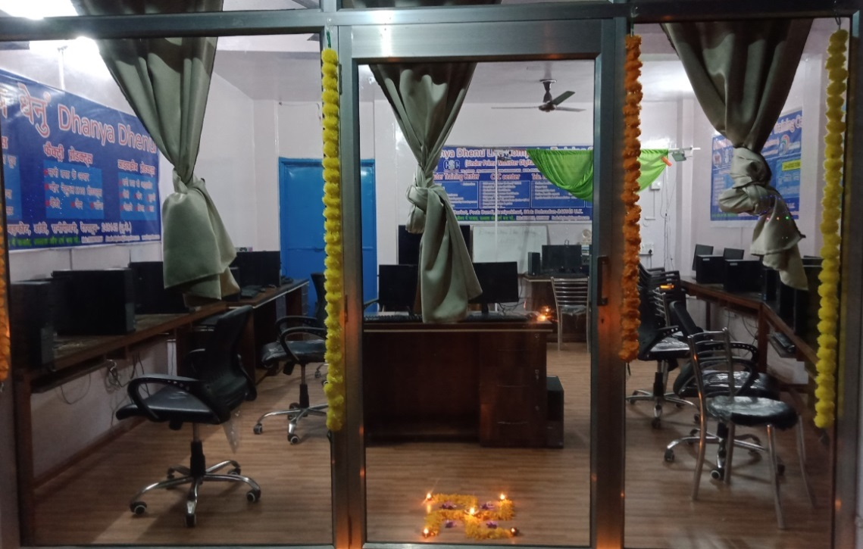
Bank CSP & CSC:
P.M Digital Village:

Slide 15
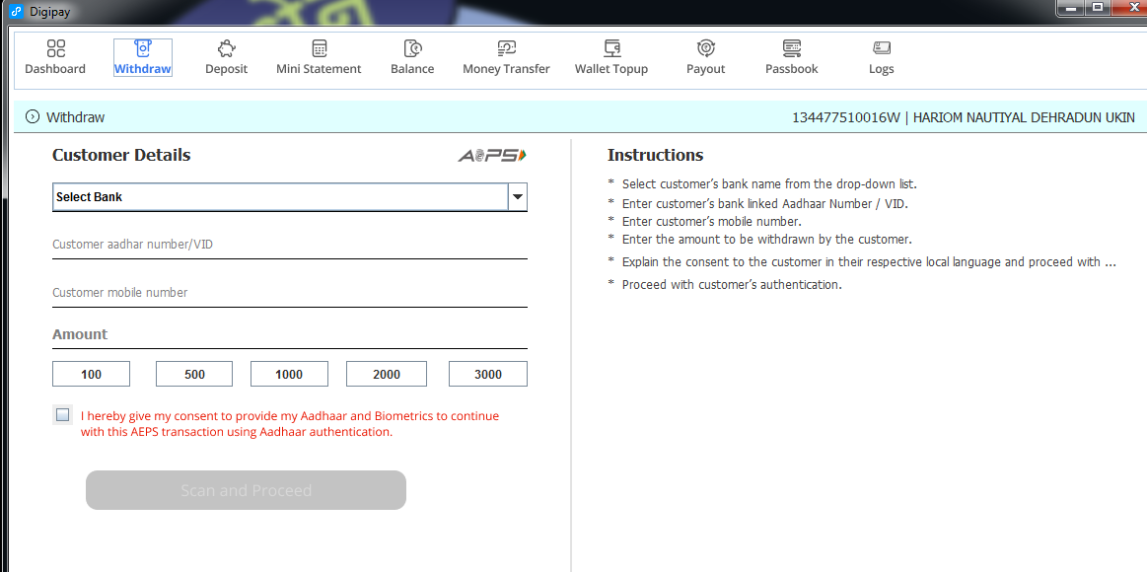
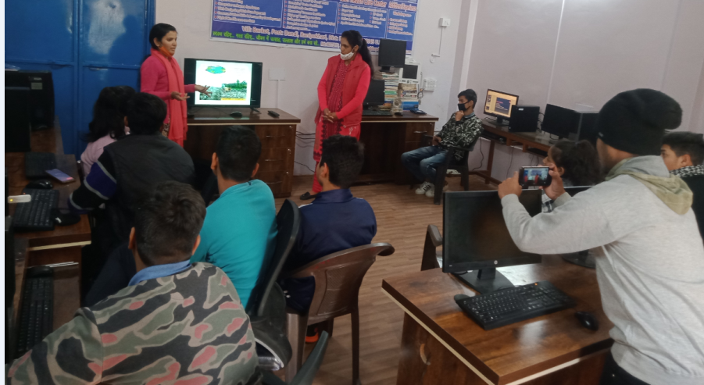
Bank CSP
DigiPay

Slide 16
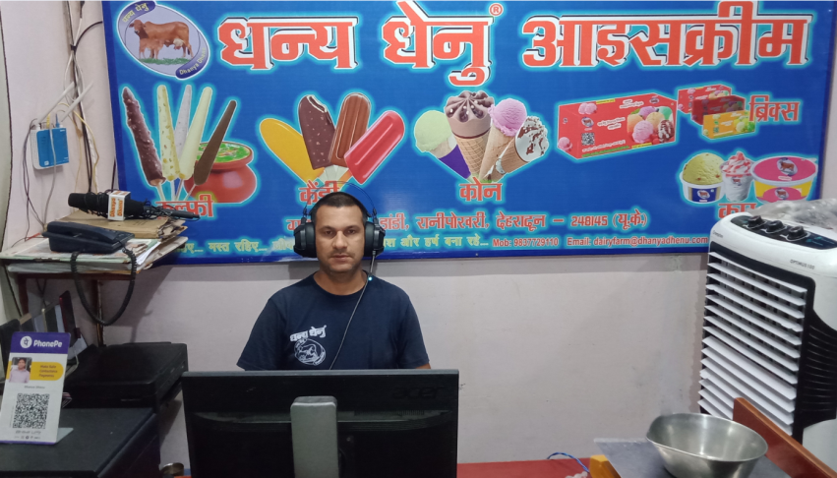
सरकारी योजनाएं जो हमारे धन्य धेनु फार्म में सफलतापूर्वक चलायी जा रही हैं :
PM Surya Ghar Yojana 10KVA scheme (Commercial)
PM FORMALISATION OF MICRO FOOD PROCESSING ENTERPRISE SCHEME
Dhanya Dhenu Trust Free computer education for 14-60 aged group(Specially women)
PMEGP: Ice-cream manufacturing unit
PM Digital Village Scheme: E- Panchayat, Wi-Fi choupal, Digital telehealthcare center etc…
PM Digital Village Scheme: Dhanya Dhenu Live computer training center
Digital India: Common Service Center (CSC - e-District Uttarakhand)
Digital India: Bank CSP (Uttarakhand Gramin Bank and ICICI Bank along with DigiPay)
NRLM: SHG activity (Pickle factory activities, Trade fair stall etc…
NABARD: Dairy farm (for 20-30 Animals)
Mukhyamantri Swarojgar Yojna: Poultry (Brown Eggs)
NABARD: Poultry venture capital fund Marketing Outlet
AHD: Mother poultry unit
UREDA: Bio-gas and vermicompost Plant

Slide 17
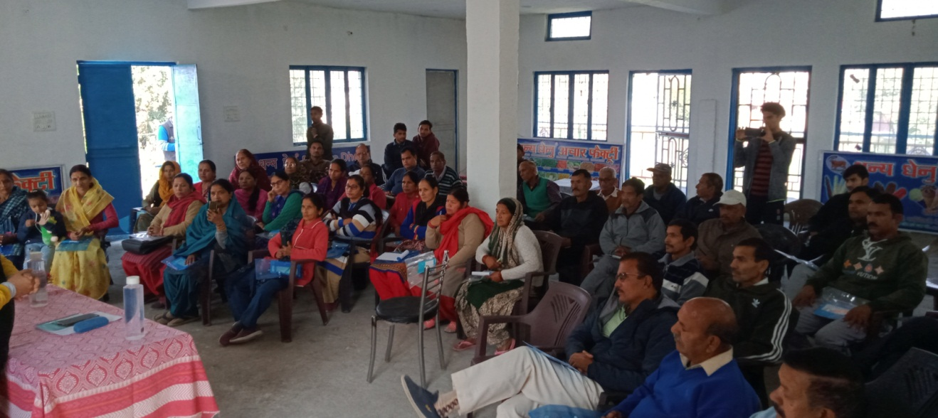
Dhanya Dhenu team members:
Full time working peoples
Founder & CEO: Hariom Nautiyal (MCA, BIT)
Director of Finance & A/c: S.O. Nautiyal (MBA, BIT)
Managing Director: Pooja Devi (B.A)
Two-five delivery-packaging boys and girls
Part time working people
Other Part time Marketing people
College students
All our SHG members
Thank You

